Slide 1
Firefox 5
The New Awesome of the Open Web

Slide 2
Firefox 5:
Released only 3 months after Firefox 4!
Notes:
Fast: making Firefox super-duper fast
Powerful: enabling new open, standard Web technologies (HTML5 and beyond!),
Empowering: putting users in full control of their browser, data, and Web experience.
http://blog.mozilla.com/blog/2010/05/10/firefox-4-vision-fast-powerful-and-empowering/

Slide 3
FireFox Release Timeline
Building The Open Web Since 2004
v 3.0 2008
v 4.0 March 2011
v 1.0 2004
V 5.0 June 2011
v 2.0 2006

Slide 4

The Firefox Roadmap
The New Plan for Firefox

Slide 5
Back To Mission
Stable & Responsive
Built for desktops and mobile
Help users get the most out of the web
Support tech desired by devs & users
Deliver these improvements quickly
Notes:
Firefox is Mozilla's expression of our manifesto and mission; it represents our vision of an Open Web Platform that is powerful, versatile, accessible, customizable, and interoperable. When we first shipped Firefox in 2004, our goal was to get the web moving again, and demonstrate the power of the technologies that made up the platform at that time.
We succeeded in re-energizing the browser market, creating competition and innovation which benefits Web application developers and users alike. This newly competitive market has presented challenges for the continued success of Firefox, and in 2011 we must ensure that we can deliver a product that is compelling to users in order to continue to be able to demonstrate our vision for the Web. To do this we must:
provide a browser that is stable and responsive,
build a product for modern desktop and mobile hardware,
provide a simple set of features & experiences to help users get the most out of the web,
support web technologies that are desired most by application developers and users,
deliver those technology improvements quickly to our user base.
It is important to remember, however, that gaining browser market share is not the only goal of Mozilla's mission. Our mission is to promote an Open Web Platform which is the most compelling environment for modern applications. Increasingly this vision is being threatened by application development models which bypass the Web in favour of directly connecting with Internet based resources in closed, proprietary models such as:
closed or single platform "App" SDKs (AIR, iOS, Android SDK, Chrome Web Store),
plug-in balkanization (h.264, .swf, NaCl),
user personalizations and customizations kept in "walled clouds"

Slide 6
Gain Market Share
+
Promote the Open Web

Slide 7
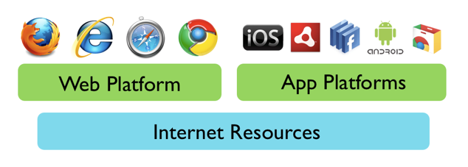
State of the Web Today
Notes:
It is important to remember, however, that gaining browser market share is not the only goal of Mozilla's mission. Our mission is to promote an Open Web Platform which is the most compelling environment for modern applications. Increasingly this vision is being threatened by application development models which bypass the Web in favour of directly connecting with Internet based resources in closed, proprietary models such as:
closed or single platform "App" SDKs (AIR, iOS, Android SDK, Chrome Web Store),
plug-in balkanization (h.264, .swf, NaCl),
user personalizations and customizations kept in "walled clouds“
These types of challenges are not new to Mozilla, and once again These types of challenges are not new to Mozilla, and once again our community must work to prove that open, interoperable technologies can exist on the same footing as closed, proprietary ones. To do this we must:
work with the community to develop and support an open web "App" model,
identify the key elements of an open and interoperable social network and develop an open standard for them within the Web.
our community must work to prove that open, interoperable technologies can exist on the same footing as closed, proprietary ones. To do this we must:
work with the community to develop and support an open web "App" model,
identify the key elements of an open and interoperable social network and develop an open standard for them within the Web.

Slide 8
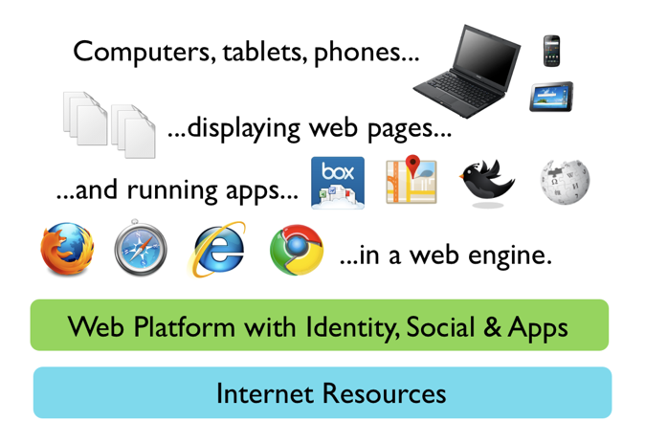
Firefox Product Vision
Notes:
It is important to remember, however, that gaining browser market share is not the only goal of Mozilla's mission. Our mission is to promote an Open Web Platform which is the most compelling environment for modern applications. Increasingly this vision is being threatened by application development models which bypass the Web in favour of directly connecting with Internet based resources in closed, proprietary models such as:
closed or single platform "App" SDKs (AIR, iOS, Android SDK, Chrome Web Store),
plug-in balkanization (h.264, .swf, NaCl),
user personalizations and customizations kept in "walled clouds“
Our mission implies a vision where the currently closed "App" ecosystem and walled social ecosystems are replaced with Open Web Platform based alternatives. While this may not be realizable within the next calendar year, a co-ordinated vision of what we're building towards will help keep our product plans on track and inform our technology choices:
These types of challenges are not new to Mozilla, and once again our community must work to prove that open, interoperable technologies can exist on the same footing as closed, proprietary ones. To do this we must:
work with the community to develop and support an open web "App" model,
identify the key elements of an open and interoperable social network and develop an open standard for them within the Web.

Slide 9
Benefit of New Release Cycle
Faster time to market
Keep better pace with web standard changes
More competitive by releasing newer code
Create a predictable release cadence
Help users feel comfortable with upgrading

Slide 10
Challenges of New Release Cycle
Needs a cultural change for success
Less time to test and QA
Harder for add-ons to keep up
Smaller feature set per release

Slide 11

Product priorities 2011
Firefox Development Objectives

Slide 12
Ship new technology to users in smaller bundles, more frequently
Notes:
Four technology shipment vehicles in 2011, including Firefox 4
Achieve a regular cadence for shipping

Slide 13
Develop a product that is responsive from "click to render"
Notes:
No more than 50ms delay between user action and application reaction
Provide optimizations to hide network latency
Obtain metrics from users in addition to our test infrastructure

Slide 14
Expand the Open Web Platform to include Apps, Social and Identity
Notes:
Design and implement open systems for Identity and social interactions
Design and implement Web Application Framework
Implement missing pieces of CSS/HTML required for compelling Web Applications

Slide 15
Never lose the user's data or state
Notes:
Continue to improve stability
Mitigate the cost of application failure
Interact with cloud-based storage to allow users to "take it with them"

Slide 16
Shine the primary UI until it gleams
Notes:
Determine and optimize top 5-10 user interaction flows (ie: search for restaurant)
Improve tools for customization/restoration of old functionality so we can remove it from primary UI
Improve user interface polish so that Firefox feels modern, graceful and elegant

Slide 17
Support modern operating systems and platforms
Notes:
support Firefox Windows 64-bit builds
OSX 10.7 system integration
Android 3.0 tablet integration
ensure JIT performs well on modern ARM CPU families

Slide 18
Plan for a future where Desktop, Mobile and Web Apps run on a common platform
Notes:
Need to design and architect towards this eventual outcome
Implementation of this is not a priority

Slide 19
Plan for a future where Desktop, Mobile and Web Apps run on a common platform
Notes:
Need to design and architect towards this eventual outcome
Implementation of this is not a priority

Slide 20
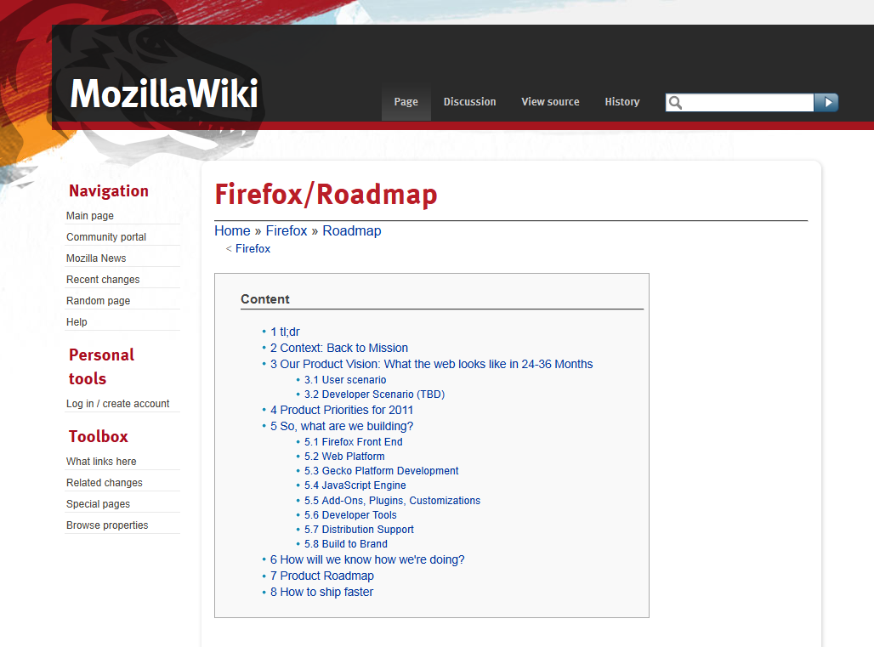
https://wiki.mozilla.org/Firefox/Roadmap

Slide 21

Firefox Five
The Lastest & Greatest

Slide 22
First release on the new Firefox Roadmap schedule

Slide 23
FF5: June 21, 2011
FF4: March 22, 2011
90 Days or 2184 Hours

Slide 24
Added Support for CSS Animations

Slide 25
Do-Not-Track Improvements
Notes:
Easier to Find
Added to Android

Slide 26
Performance Improvements
Notes:
Tuned HTTP idle connection logic for increased performance
Improved canvas, JavaScript, memory, and networking performance
Background tabs have setTimeout and setInterval clamped to 1000ms to improve performance
Lots of Android performance improvements

Slide 27
HTML5
Improvements
Notes:
Improved standards support for HTML5, XHR (XMLHttpRequest), MathML, SMIL (Synchronized Multimedia Integration Language), and canvas

Slide 28
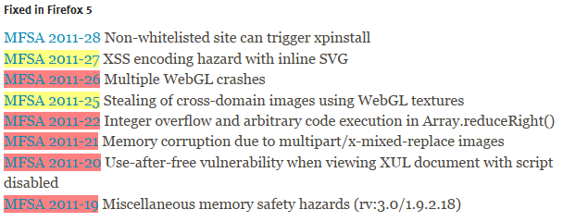
Security Fixes
Notes:
WebGL content can no longer load cross-domain textures

Slide 29

Firefox Six
What’s Next?

Slide 30
Welcome to the World of Rapid Release

Slide 31
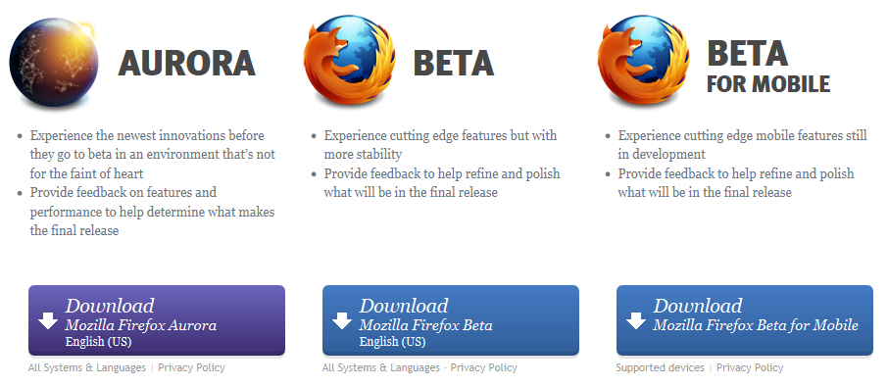

Slide 32
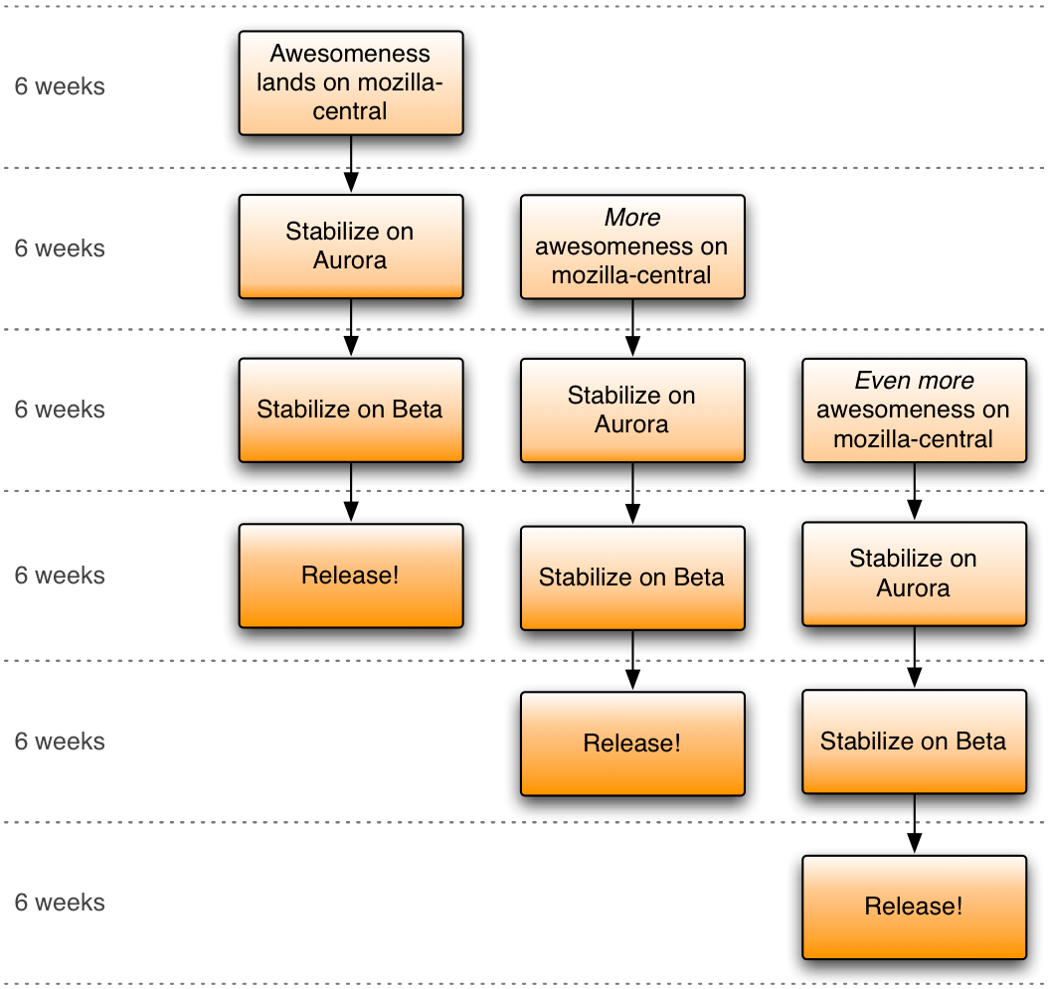
A New Firefox Every 6 Weeks

Slide 33
“It’s clear that rapid release is a major improvement in our ability to respond to the needs of our users and the web... Rapid release is already paying dividends, and we’re just getting started.”
Johnathan Nightingale
Director of Firefox Engineering
http://blog.mozilla.com/futurereleases

Slide 34
New for Windows, Mac & Linux
Add-Ons Manager with Plug-In Checker
Improved Panorama & Web Console
Scratchpad: Build & Test JS in browser
WebSockets
Server-Sent Events
And More!
Notes:
Web Sockets: The WebSocket specification—developed as part of the HTML5 initiative—introduced the WebSocket JavaScript interface, which defines a full-duplex single socket connection over which messages can be sent between client and server. The WebSocket standard simplifies much of the complexity around bi-directional web communication and connection management.
Server-Sent Events: EventSource landed in Aurora 6. It is a new and simplified way to open long-lived connections to a server, and let the browser create events as the server streams messages to the client. It is also available in Chrome and Opera and there are fallback solutions for other browsers.

Slide 35
New for Android
Faster start up with less memory
Better image scaling
Improved experience on tablets
Touch Events
Faster offline access

Slide 36
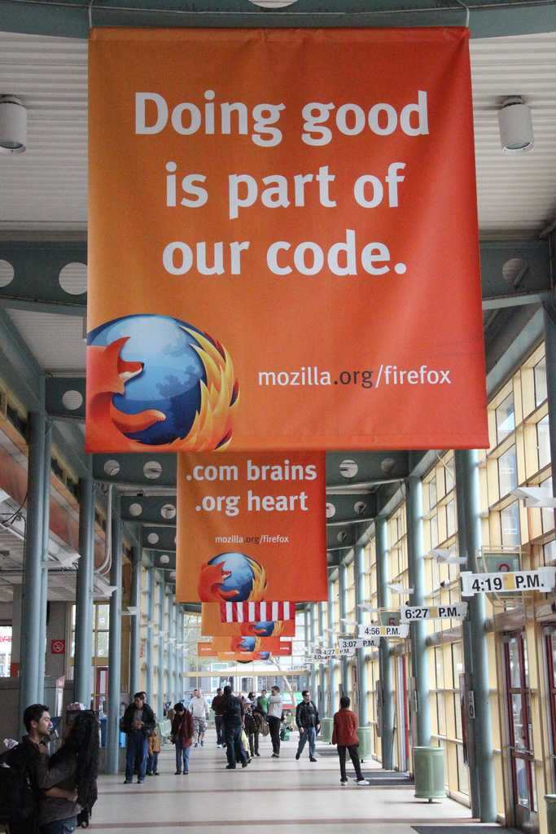
Mozilla Mission
Promote openness, innovation and opportunity on the web.
http://www.flickr.com/photos/kerolic/5803257147/

Slide 37

Help Make the
Open Web More Awesome
Mozilla.org/firefox
Sean Yo
me@seanyo.ca
@seanyo +Sean Yo
https://github.com/seanyo

